Slide 1
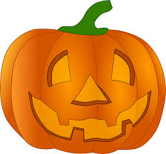
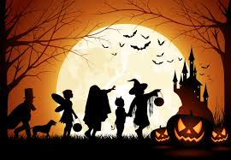
Halloween

Slide 2
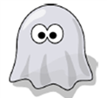
a ghost

Slide 3

a witch

Slide 4

a skeleton

Slide 5

a monster

Slide 6

a mummy

Slide 7
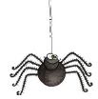
a spider

Slide 8
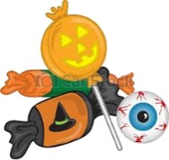
candies

Slide 9

a vampire

